Slide 1
OST MISC/TRA estimated performance v3
Aug. 30th 2018
Taro Matsuo

Slide 2
Optical design
The OST MISC transit spectrograph was successfully updated as follows;
The observing wavelength ranges from 2.8 to 20µm
The number of the detector samplings are optimized because of the higher dark current of MCT detector and smaller diameter:
- The number of samplings for each spectral element is 135 pixels for short, 270 pixels for middle and 340 pixels for long band.
The higher throughput over the entire wavelength range is provided.

Slide 3
Updated optical design
Generated by Yamamuro-san
Additional field stop is added.
Additional field stop is added for reduction of

Slide 4
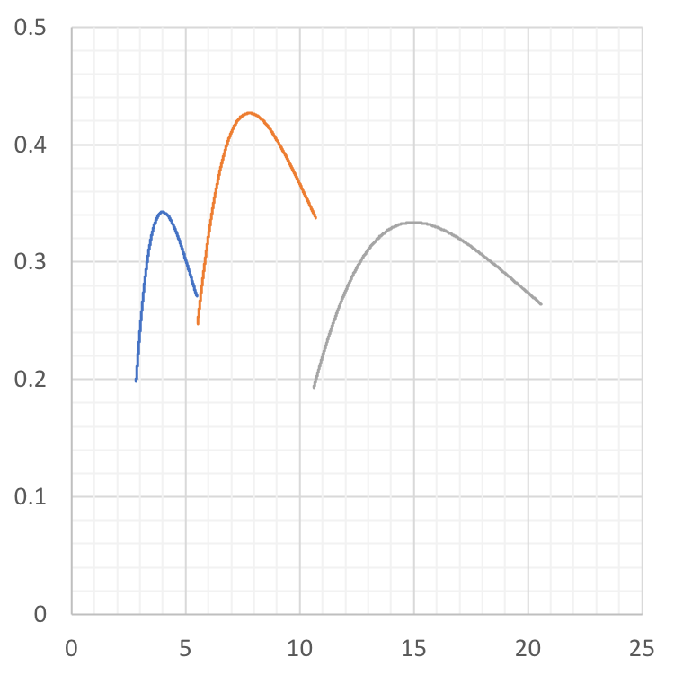
Throughput
Band 2
 | Band 1 | Band 2 | Band 3
wavelength [µm] | 2.8-5.5 | 5.5-10.5 | 11-20
Telescope (x4) | 0.97 | 0.98 | 0.98
Relay mirror (x6) | 0.96 | 0.96 | 0.96
Densified pupil spectrograph (x 7) | 0.96 | 0.96 | 0.96
Dichroich mirror 1 | 0.8 | 0.8 | 0.9
Dichroich mirror 2 | 0.8 | 0.9 | 1
Grating at peak | 1 | 1 | 1
AR coat lens | 0.94 | 0.94 | 0.66
detector quantum efficiency | 0.88 | 0.78 | 0.7
Contamination/slit loss | 0.9 | 0.9 | 0.9
Band 1
Band 3
Throughput
For more information, please refer to Appendix.
Wavelength (µm)

Slide 5
Zodiacal light
A: Scattered component
B: Emissive component
A+B model was applied for calculation.
The field of view was tentatively set to 2.5” and additional field stop with radius of 1.5”is added to the long channel.
Wavelength (µm) | Background (MJy/steradian)
3 | 0.1
5 | 0.35
6 | 1
8 | 3
10 | 8.5
11 | 11
14 | 14
20 | 17
* The background at 3µm was derived from extrapolation.
Glasse et al. PASP 2015

Slide 6
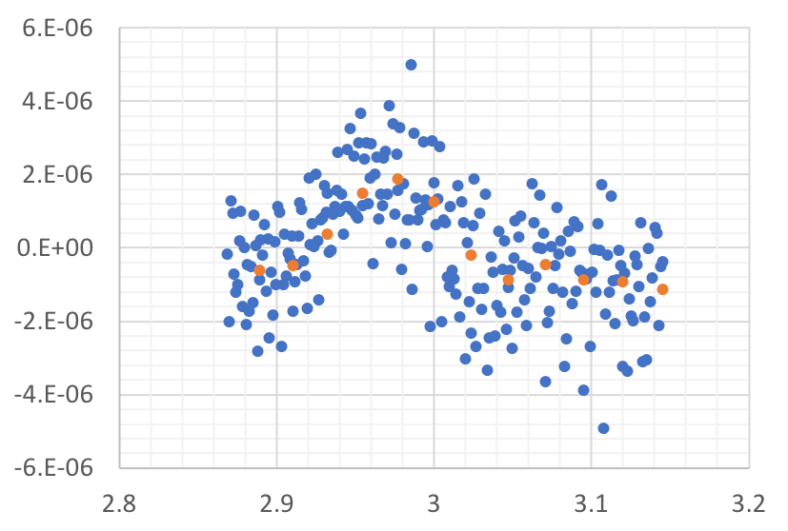
Spectrophotometric accuracy
Blue dot: light of 0.0015µm (monochromatic light)
Orange dot: light of bandwidth of R~100 (chromatic light)
Lambda = 3µm
3µm simulation image (from James Corsetti)
+ 9 mas jitter
Photometric variance
σ
Calculating photometric variance as monochromatic light
Imitating chromatic light and evaluating its photometric variation
Deriving spectrophotometric accuracy of chromatic light from standard deviation, σ.
Wavelength (µm)

Slide 7
Parameters
Wavelength | # of transits | Spectral resolution | Dark current | Field stop radius
3µm | 84 | 50 | 1.0 e-/s | 2.5”
5µm | 84 | 50 | 1.0 e-/s | 2.5”
8µm | 84 | 50 | 1.0 e-/s | 2.5”
10µm | 84 | 50 | 1.0 e-/s | 2.5”
14µm | 84 | 206 (stellar activity mode) 20 (SED measurement) | 0.2 e-/s | 1.5”
20µm | 84 | 295 (stellar activity) 20 (SED measurement) | 0.2 e-/s | 1.5”

Slide 8
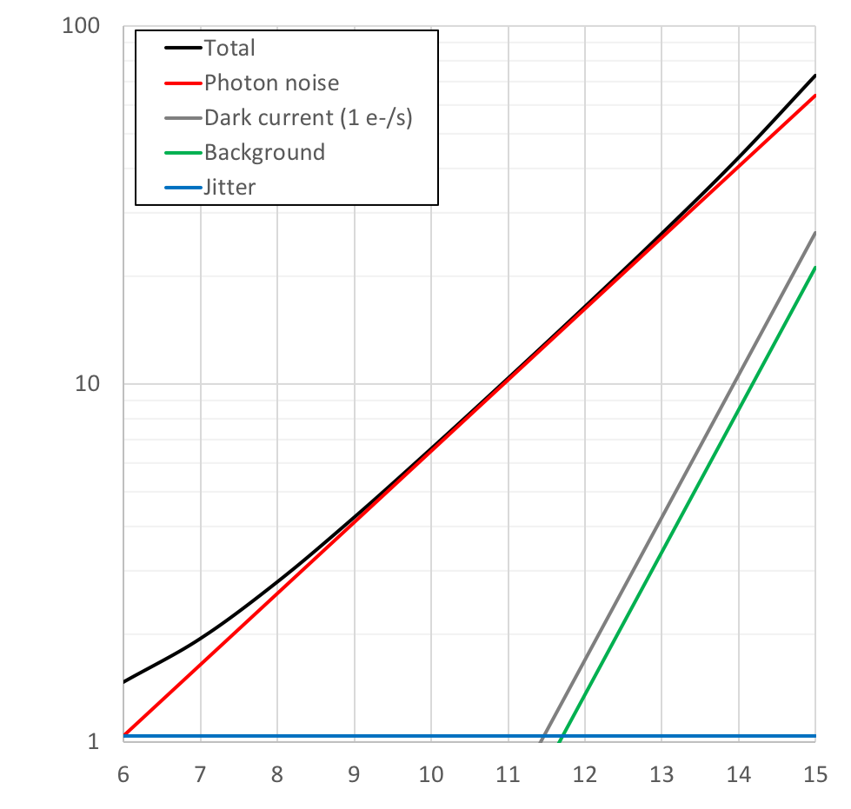
OST MISC/TRA noise performance at 3µm
K (mag) | M8 (pc) | M5 (pc) | M1 (pc)
6 | 1.3 | 2.7 | 7.8
7 | 2.1 | 4.2 | 12.4
8 | 3.3 | 6.7 | 19.6
9 | 5.2 | 10.6 | 30.9
10 | 8.2 | 16.8 | 48.9
11 | 13.0 | 26.5 | 77.3
12 | 20.5 | 41.9 | 122.2
13 | 32.4 | 66.2 | 193.2
14 | 51.3 | 104.7 | 305.5
15 | 81.0 | 165.5 | 483
84 transits
R=52
Stability [ppm]
5ppm
K magnitude
* The results do not strongly depend on the spectral type of a host star.

Slide 9
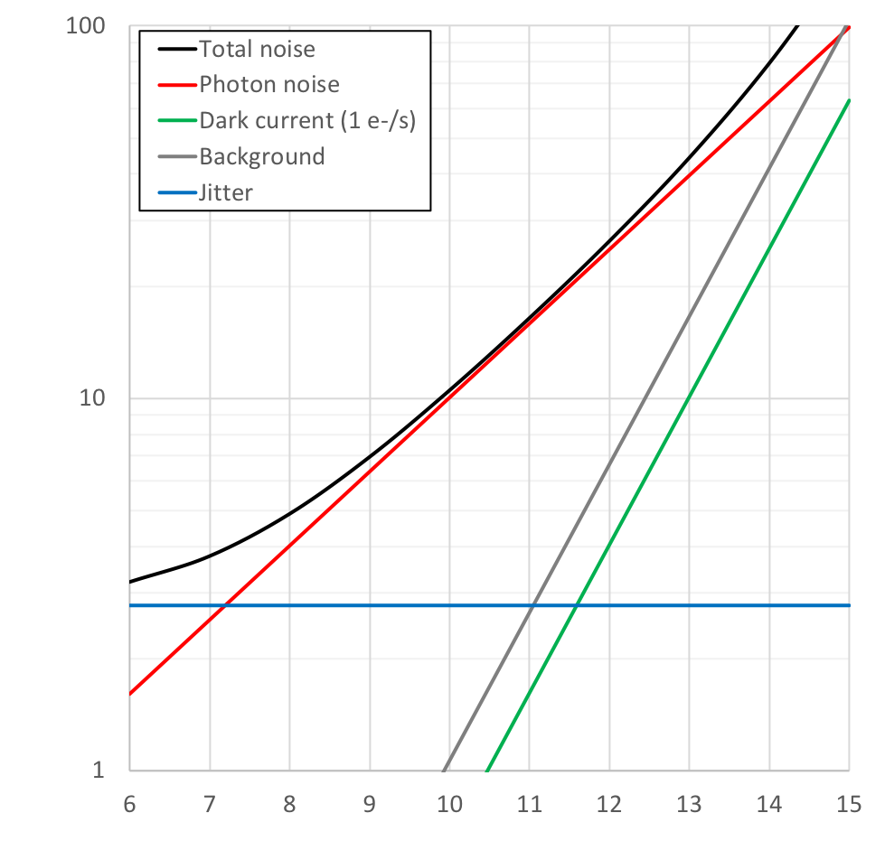
OST MISC/TRA noise performance at 5µm
K (mag) | M8 (pc) | M5 (pc) | M1 (pc)
6 | 1.3 | 2.7 | 7.8
7 | 2.1 | 4.2 | 12.4
8 | 3.3 | 6.7 | 19.6
9 | 5.2 | 10.6 | 30.9
10 | 8.2 | 16.8 | 48.9
11 | 13.0 | 26.5 | 77.3
12 | 20.5 | 41.9 | 122.2
13 | 32.4 | 66.2 | 193.2
14 | 51.3 | 104.7 | 305.5
15 | 81.0 | 165.5 | 483
84 transits
R=52
Stability [ppm]
5ppm
K magnitude
* The results do not strongly depend on the spectral type of a host star.

Slide 10
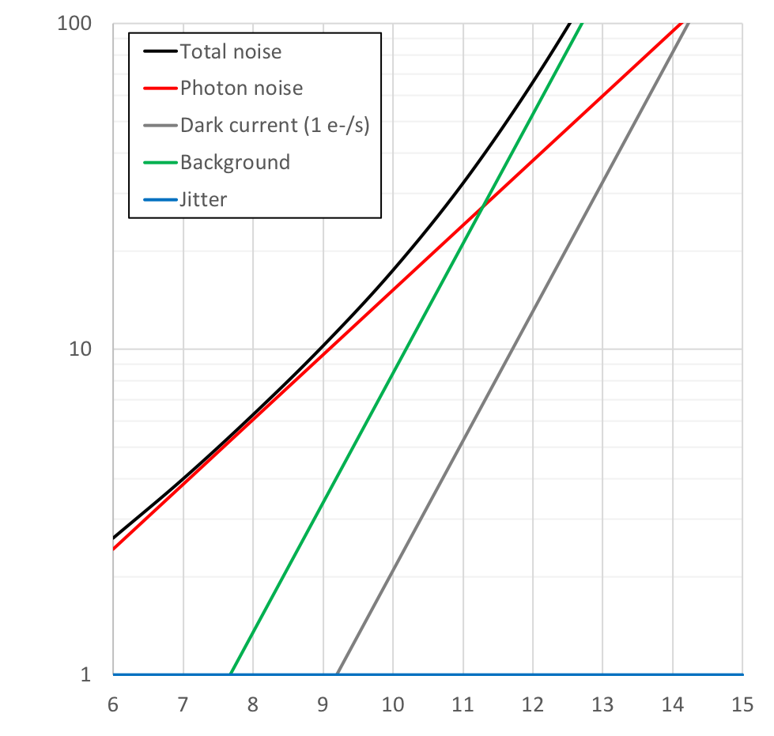
OST MISC/TRA noise performance at 8µm
K (mag) | M8 (pc) | M5 (pc) | M1 (pc)
6 | 1.3 | 2.7 | 7.8
7 | 2.1 | 4.2 | 12.4
8 | 3.3 | 6.7 | 19.6
9 | 5.2 | 10.6 | 30.9
10 | 8.2 | 16.8 | 48.9
11 | 13.0 | 26.5 | 77.3
12 | 20.5 | 41.9 | 122.2
13 | 32.4 | 66.2 | 193.2
14 | 51.3 | 104.7 | 305.5
15 | 81.0 | 165.5 | 483
84 transits
R=52
Stability [ppm]
5ppm
<1 ppm
K magnitude
* The results do not strongly depend on the spectral type of a host star.

Slide 11
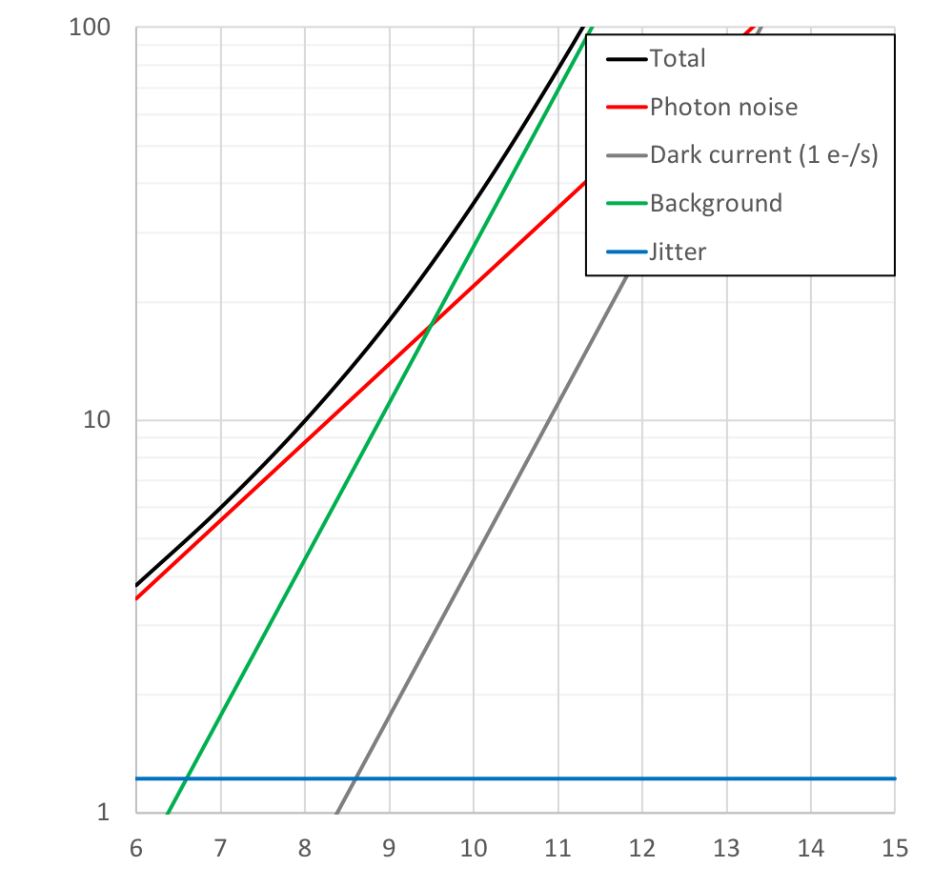
OST MISC/TRA noise performance at 10µm
K (mag) | M8 (pc) | M5 (pc) | M1 (pc)
6 | 1.3 | 2.7 | 7.8
7 | 2.1 | 4.2 | 12.4
8 | 3.3 | 6.7 | 19.6
9 | 5.2 | 10.6 | 30.9
10 | 8.2 | 16.8 | 48.9
11 | 13.0 | 26.5 | 77.3
12 | 20.5 | 41.9 | 122.2
13 | 32.4 | 66.2 | 193.2
14 | 51.3 | 104.7 | 305.5
15 | 81.0 | 165.5 | 483
84 transits
R=52
Stability [ppm]
5ppm
K magnitude
* The results do not strongly depend on the spectral type of a host star.

Slide 12
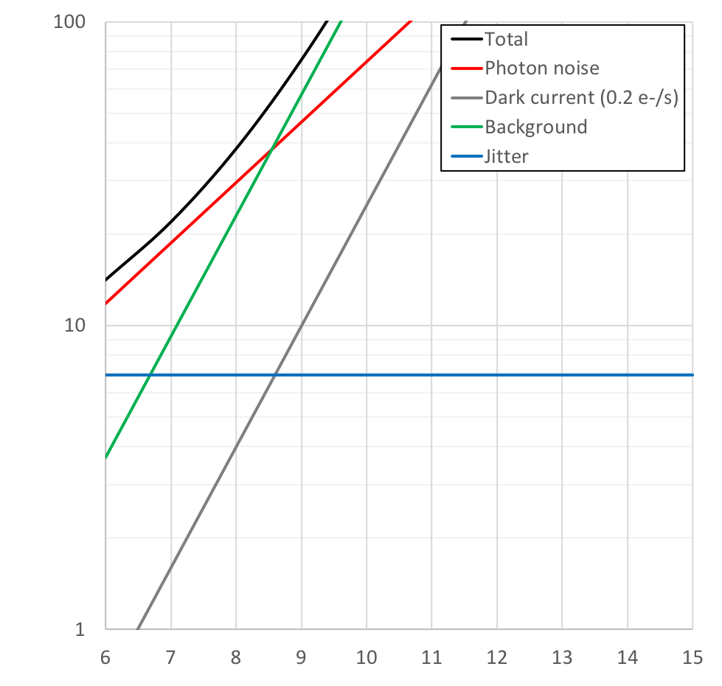
OST MISC/TRA noise performance at 14µm
Stellar activity monitor
K (mag) | M8 (pc) | M5 (pc) | M1 (pc)
6 | 1.3 | 2.7 | 7.8
7 | 2.1 | 4.2 | 12.4
8 | 3.3 | 6.7 | 19.6
9 | 5.2 | 10.6 | 30.9
10 | 8.2 | 16.8 | 48.9
11 | 13.0 | 26.5 | 77.3
12 | 20.5 | 41.9 | 122.2
13 | 32.4 | 66.2 | 193.2
14 | 51.3 | 104.7 | 305.5
15 | 81.0 | 165.5 | 483
84 transits
R=206
Stability [ppm]
5ppm
K magnitude
* The results do not strongly depend on the spectral type of a host star.

Slide 13
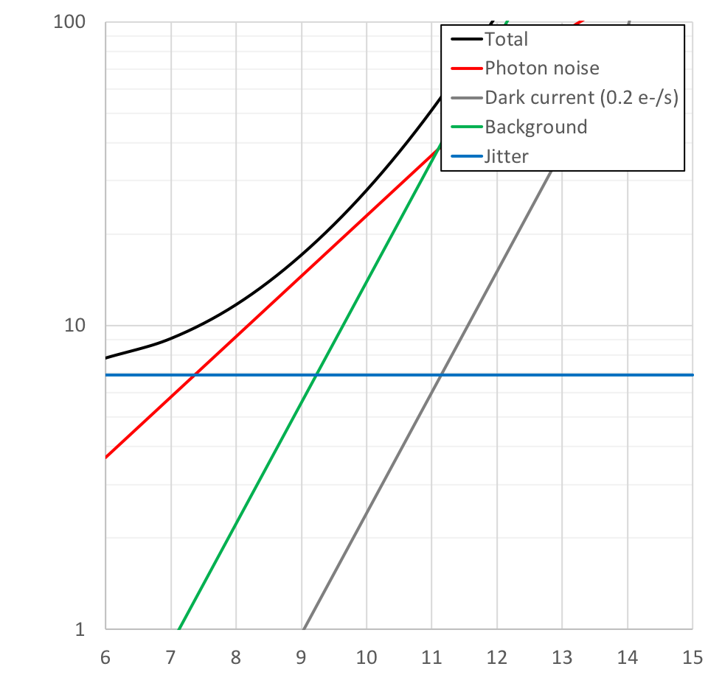
OST MISC/TRA noise performance at 14µm
SED measurement
84 transits
R=20
K (mag) | M8 (pc) | M5 (pc) | M1 (pc)
6 | 1.3 | 2.7 | 7.8
7 | 2.1 | 4.2 | 12.4
8 | 3.3 | 6.7 | 19.6
9 | 5.2 | 10.6 | 30.9
10 | 8.2 | 16.8 | 48.9
11 | 13.0 | 26.5 | 77.3
12 | 20.5 | 41.9 | 122.2
13 | 32.4 | 66.2 | 193.2
14 | 51.3 | 104.7 | 305.5
15 | 81.0 | 165.5 | 483
Stability [ppm]
5ppm
K magnitude
* The results do not strongly depend on the spectral type of a host star.

Slide 14
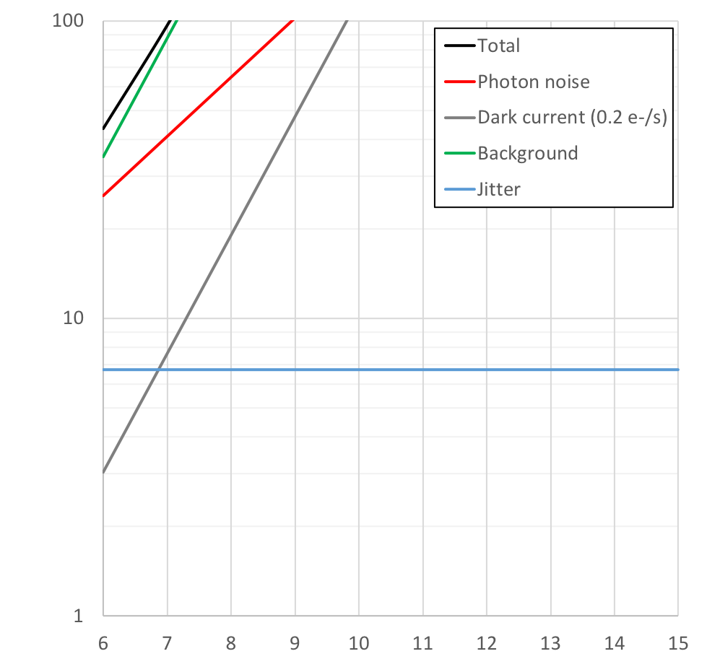
OST MISC/TRA noise performance at 20µm
Stellar activity monitor
K (mag) | M8 (pc) | M5 (pc) | M1 (pc)
6 | 1.3 | 2.7 | 7.8
7 | 2.1 | 4.2 | 12.4
8 | 3.3 | 6.7 | 19.6
9 | 5.2 | 10.6 | 30.9
10 | 8.2 | 16.8 | 48.9
11 | 13.0 | 26.5 | 77.3
12 | 20.5 | 41.9 | 122.2
13 | 32.4 | 66.2 | 193.2
14 | 51.3 | 104.7 | 305.5
15 | 81.0 | 165.5 | 483
84 transits
R=295
Stability [ppm]
5ppm
K magnitude
* The results do not strongly depend on the spectral type of a host star.

Slide 15
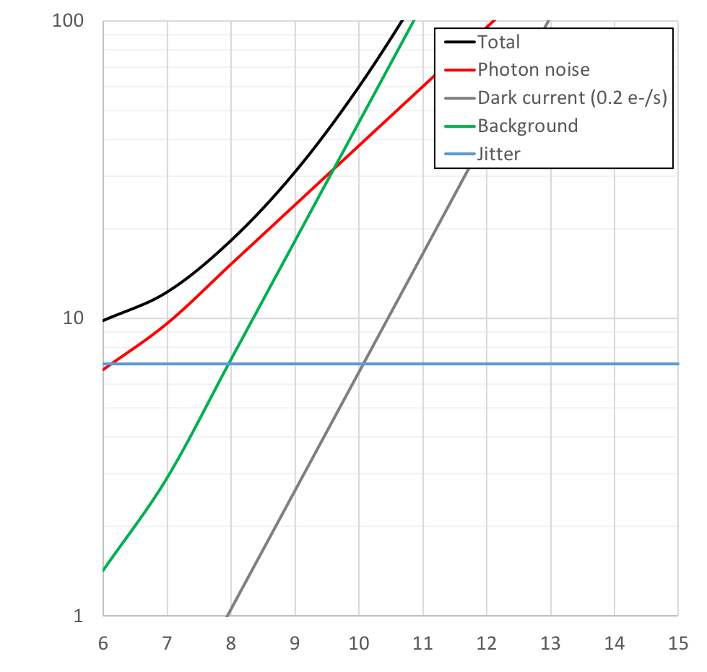
OST MISC/TRA noise performance at 20µm
SED measurement
84 transits
R=20
K (mag) | M8 (pc) | M5 (pc) | M1 (pc)
6 | 1.3 | 2.7 | 7.8
7 | 2.1 | 4.2 | 12.4
8 | 3.3 | 6.7 | 19.6
9 | 5.2 | 10.6 | 30.9
10 | 8.2 | 16.8 | 48.9
11 | 13.0 | 26.5 | 77.3
12 | 20.5 | 41.9 | 122.2
13 | 32.4 | 66.2 | 193.2
14 | 51.3 | 104.7 | 305.5
15 | 81.0 | 165.5 | 483
Stability [ppm]
5ppm
K magnitude
* The results do not strongly depend on the spectral type of a host star.

Slide 16
Appendix

Slide 17
Calculation of efficiency for OST MISC concept 2 v2
July 23, 2018
Taro Matsuo

Slide 18
Configuration of OST Concept 2
Four gold mirrors
Seven gold mirrors
Four gold mirrors
Telescope
Relay optical systems
Densified pupil system
Three gold mirrors
Dichroic mirrors
Transmission
grating
Four or three
AR-coated lens
Detector
Spectrograph
Notes:
Lens broken,,,
Two aspheric lenses -> measurement and
-> mount for lenses.
Beam alignment, toward flight.

Slide 19
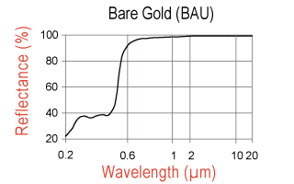
Gold mirror
Two types of gold mirrors are considered.
The reflectivity was set to:
for protected gold mirror, 0.985 in shortest channel, 0.988 in middle one, 0.990 in longer one.
for bare gold mirror, 0.994 in all channels
Edmund optics
Rocky Mountain Instrument
Notes:
Dust coverage, cleanes
What’s the requirement?
Organic,
By the end of the flight. ->
L2 ( reference from JWST); SPIE paper;

Slide 20
Two Configurations for dichroic mirror
10.5-20 µm
2.8-20µm
2.8-5.5 µm
2.8-20µm
5.5-10.5µm
2.8-5.5 µm
5.5-10.5µm
10.5-20 µm
Configuration 1 (Current)
Configuration 2 (Current)

Slide 21
Dichroic mirror
I asked about the performances of two dichroic mirrors used for the OST concept 1 (6-25µm) to MATERION;
the material is KRS-5
the following reflectivity and transmissivity are expected and developments are necessary
the reflectivity is probably higher than 90 % over the whole wavelength range.
the transmissivity is probably higher than 80 % for 6- 14µm and 70% for 14-25µm.
In this calculation, the reflectivity was set to 90% for the three channels and the transmissivity was set to 80% for the shortest and middle channels and 70% for the lonest one.

Slide 22
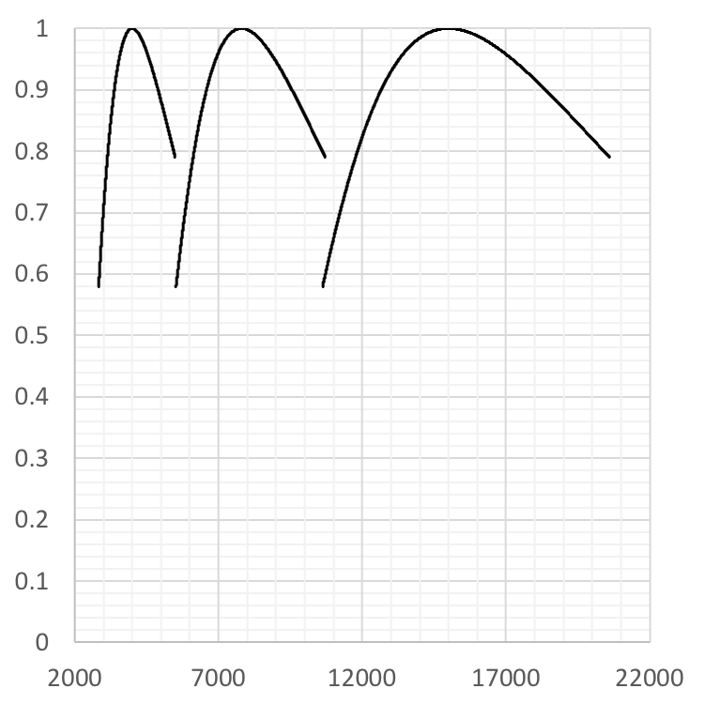
Relative grating efficiency
Blaze wavelength:
4000nm for channel 1
7800nm for channel 2
15000nm for channel 3
The peak of the efficiency was set to 0.8 for all channels.
Relative Efficiency
Wavelength (nm)

Slide 23
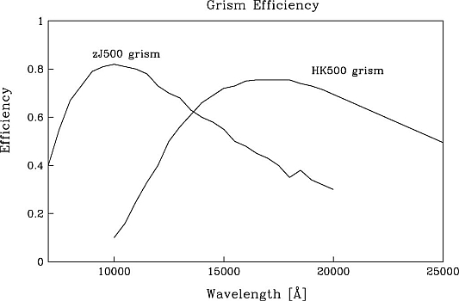
Grism Efficiency
Ge grism for LBT/LMIRCam (Kuzumenko et al. 2012)
Si Grism for JWST (Deen et al. 2016)
KRS-5 for Subaru/MOIRCS (Tokoku et al. 2007)

Slide 24
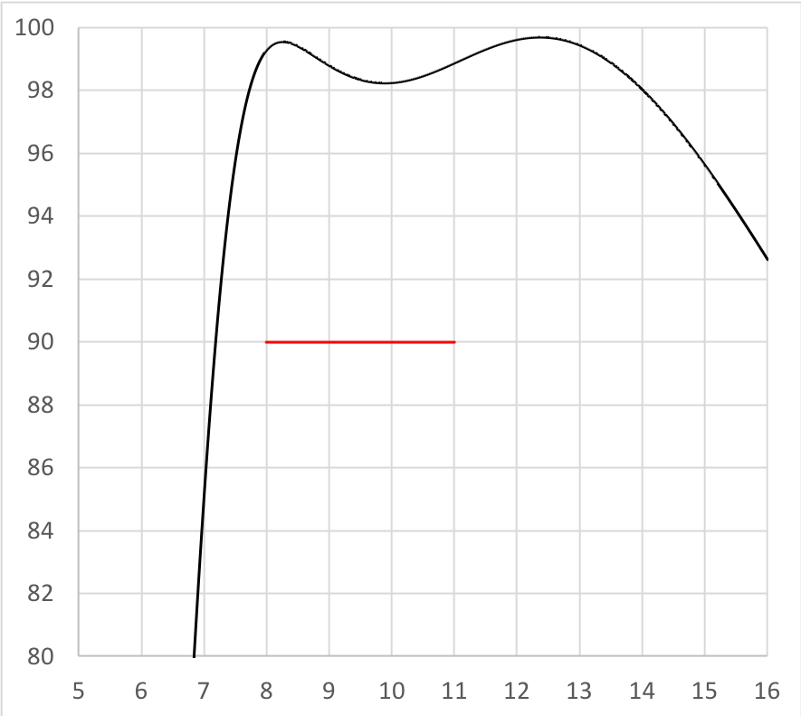
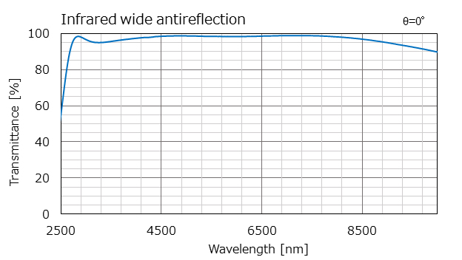
AR coat
AR coat is commonly used for the wavelength shorter than 12µm.
There are several companies that provide AR coat with 95% transmissivity.
In this simulation, transmissivity of each lens was set to 98% for the shortest and middle channels and 90% for the longest channel.
Wavelength (µm)
Transmission curve of Ge lens used for testbed
Wide anti-reflection coating for optical window

Slide 25
Detector responsivity
5.5µm- and 10.5µm-cut HgCdTe detectors can be used for the shortest and middle channels.
The detector responsivities were set to 0.88 and 0.78 for the shortest and middle channels.
5.5µm cut HgCdTe detector (Rauscher et al. 2018)
McMurty et al. 2013
Notes:
CdZnSe -> n ~ index,

Slide 26
Detector responsivity (longest channel)
Si:As detector with 16µm AR-coated window was referred as the responsivity.
The detector responsivity for the longest wavelength was set to 70%.
Rieke et al. 2015

